Slide 1


Data Governance @ SneakerPark
Prepared by:
Submitted on:

Slide 2
Background
SneakerPark is an online shoe reseller that allows people to buy and sell used and new shoes. Buyers can bid for shoes or buy them outright, and sellers can set a price or sell to the highest bidder.
Each buyer and seller must have an active account in order to sell, bid, or purchase sneakers using SneakerPark’s website.
SneakerPark authenticates the shoes before shipping them to the buyer, so before listing an item, the seller must ship it to SneakerPark’s warehouse. Upon receipt, SneakerPark assigns an item number to each pair of sneakers and notifies the seller that they are now free to list their item. If the item is not listed within 45 days, SneakerPark returns it to the seller and sends an invoice to the seller for the shipping cost.
If the item is found to be inauthentic or in an unacceptable condition, it is also returned back to the seller in a similar fashion.
When the item sells, the buyer’s account is credited with the purchase price minus the SneakerPark service fee and shipping fees to deliver the item to the buyer.
Currently, SneakerPark only supports sales within the United States.

Slide 3
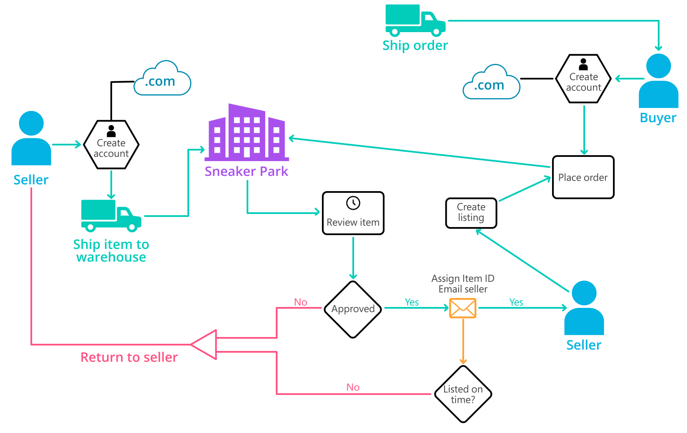
Background (cont’d)
Below you can see a diagram that will hopefully help you visualize some of SneakerPark's business processes. Keep in mind that it does not capture ALL processes and every nuance, but simply serves as another artifact to use in your project.

Slide 4
Step 1
Enterprise Data Catalog Part 1: Enterprise Data Model

Slide 5
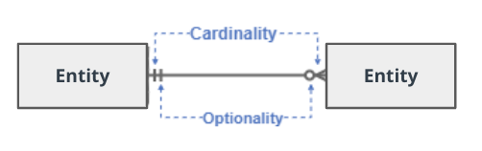
Create a conceptual data model that will provide SneakerPark with a holistic view of its data systems and help you grasp the organization's important entities and relationships, which will be instrumental as you move further in the project. You can use Lucidchart or any other diagramming tool of your choice, but please use the Crow’s Foot/IE Notation and please be sure to indicate both cardinality (the type of a relationship such as 1:N or N:N) and optionality (whether the relationship is optional or mandatory).

Slide 6
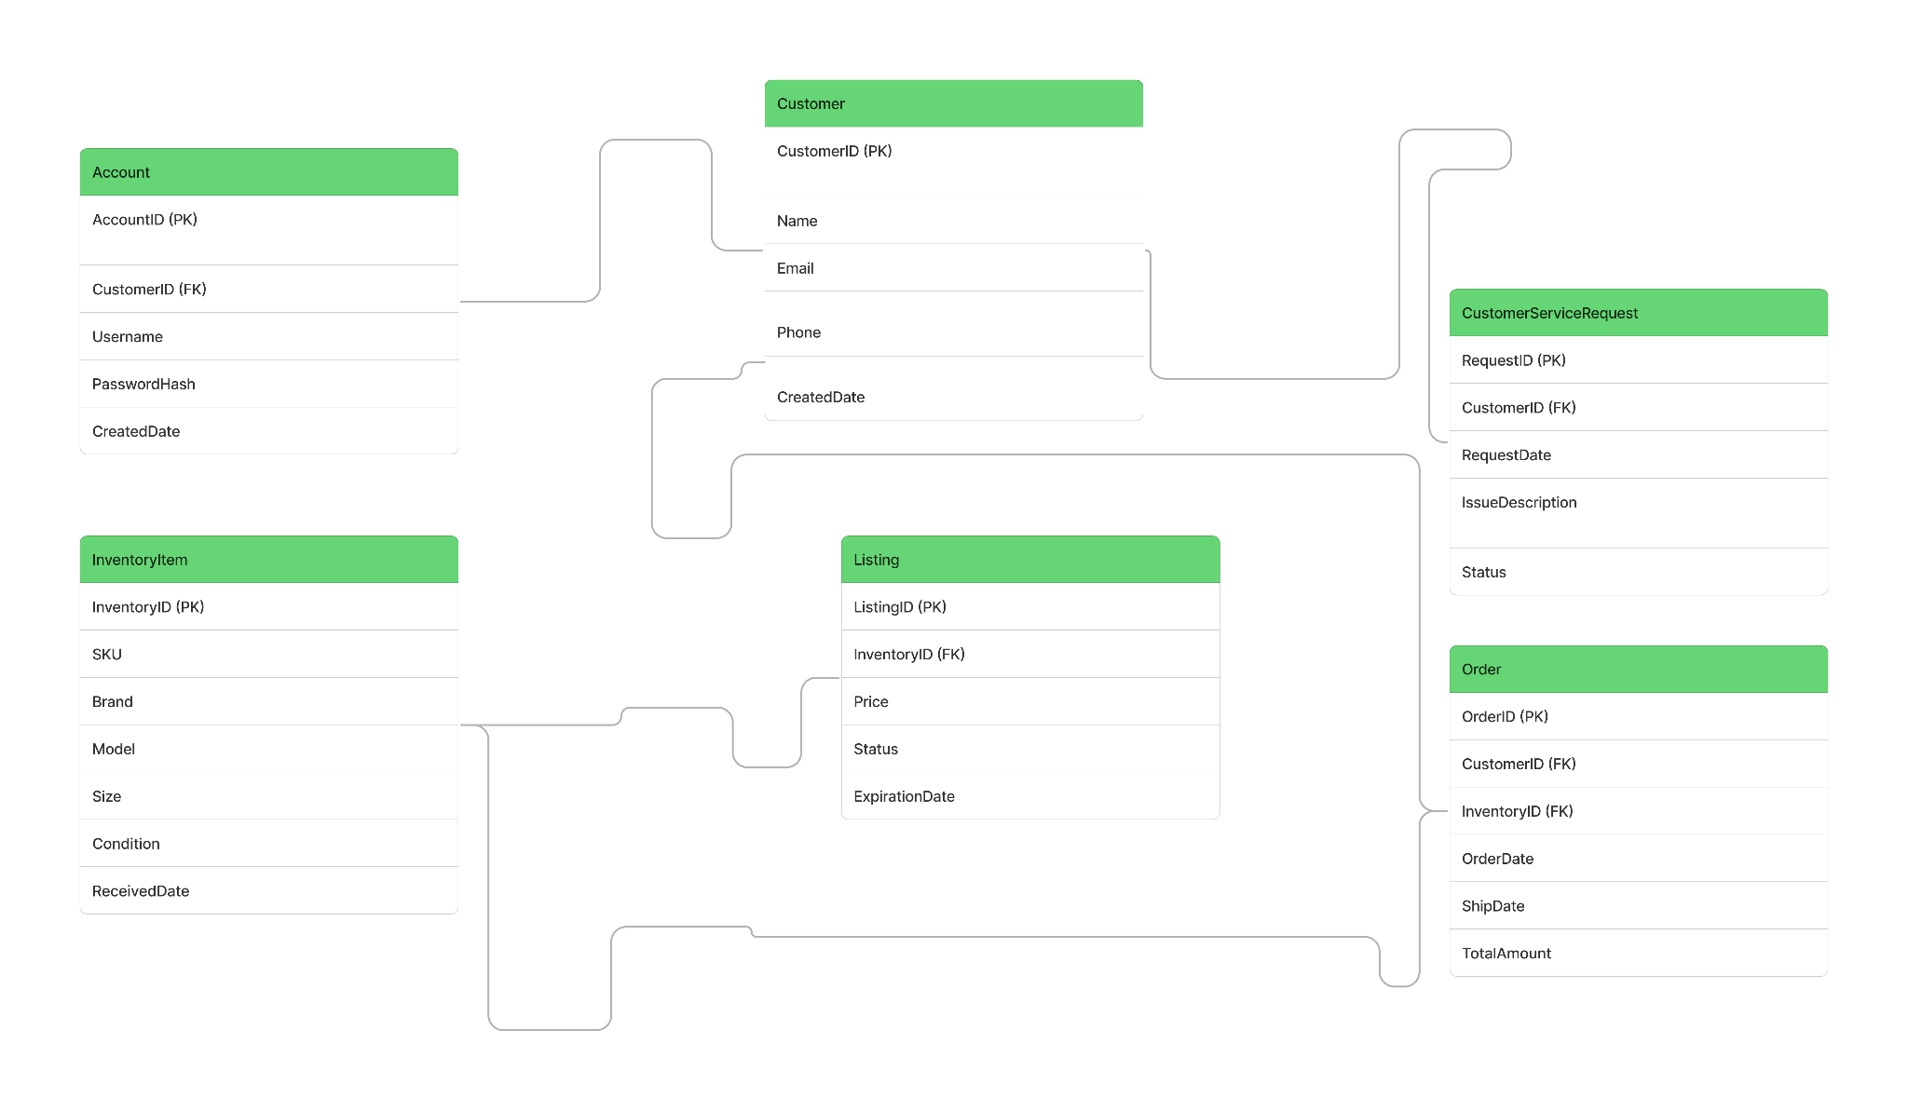
Replace the example below with your own solutions (obviously feel free to take more space):

Slide 7
Step 2
Enterprise Data Catalog Part 2: Metadata

Slide 8
Create the first version of the Metadata Catalog by documenting the metadata from all systems in the "Data Dictionary" and the “Enterprise Data Catalog” tabs of the provided Sheets template.
Please note that you are required to fill out all fields in both tabs.

Slide 9
Step 3
Data Quality
Part 1: Profiling and Cleansing

Slide 10
Profile the data to identify at least 3 data quality issues you see in the data. Also provide at least 1 data quality issue that you haven’t yet seen in the data, but can foresee occurring in the future. Based on the issues you’ve identified, come up with the data quality rule for each data quality issue, including for the one that you foresee.
Make sure you fill out all columns in the "Data Quality Issues" tab with your answers in the provided Sheets template.

Slide 11
Step 4
Data Quality
Part 2: Monitoring

Slide 12
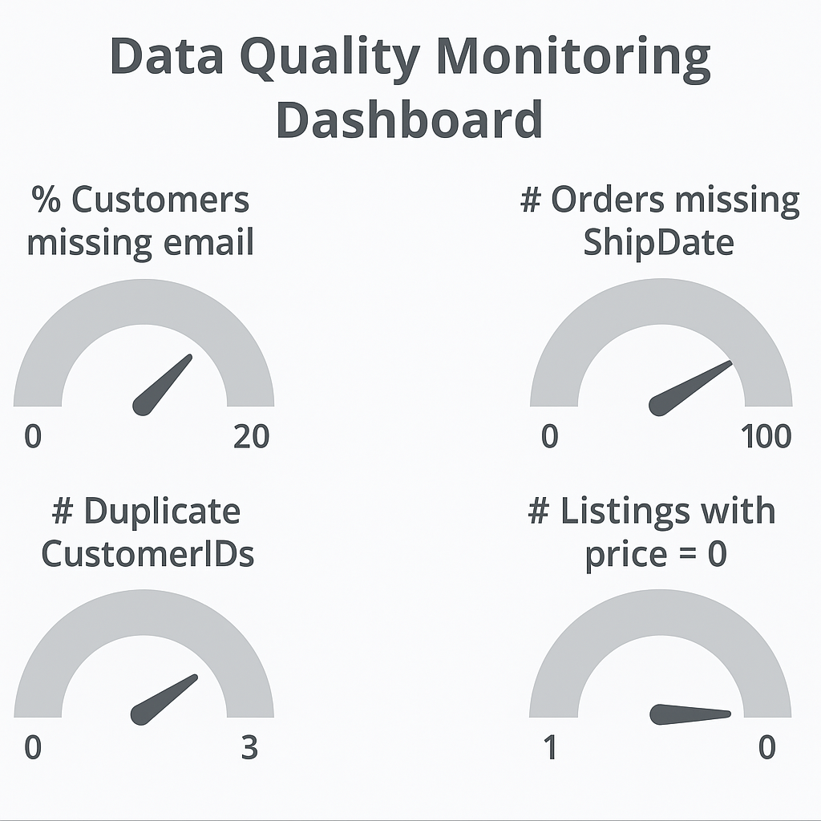
Using the metrics you've created in the last step, please create a mock-up of a data quality monitoring dashboard that will be used to monitor the data to ensure compliance with your data quality rules.
Please make sure to label your metrics clearly on your mock-up.
Replace the example dashboard below with your own. (obviously feel free to take more space).

Slide 13
Step 5
Master Data Management
Part 1: MDM Architecture

Slide 14
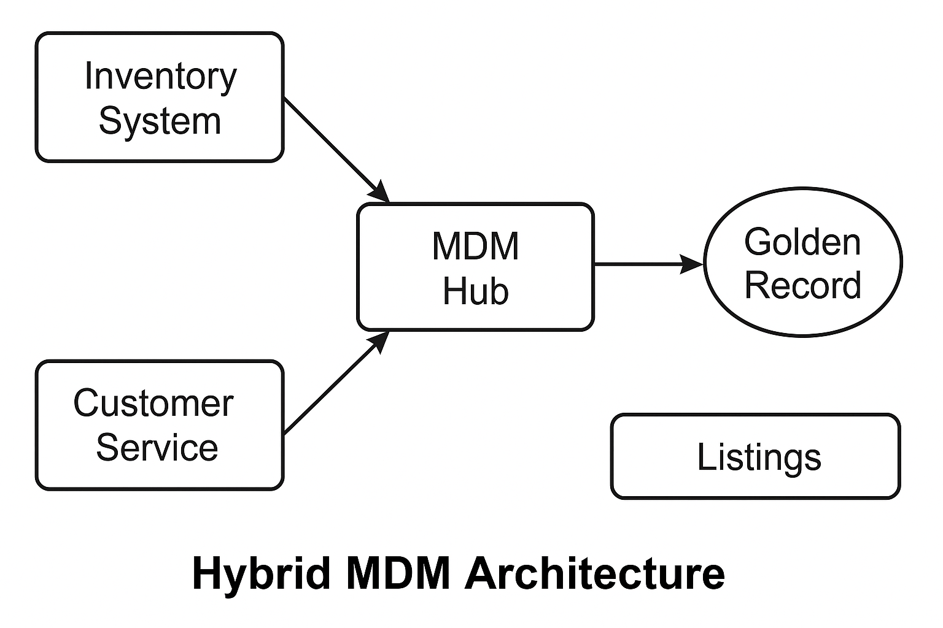
Based on what you’ve read about SneakerPark’s systems and business model, sketch out a proposed MDM implementation architecture, and write a detailed explanation of why you chose this specific approach.
Tip: Think about how your plan and its implementation might affect existing systems.
Replace example screenshot below with your own solutions (obviously feel free to take more space).
Next, please write at least a paragraph explaining your choice.

Slide 15
Explanation:
Based on SneakerPark’s current ecosystem, I propose a Hybrid MDM Architecture that combines elements of both Consolidation and Centralized models. This approach allows SneakerPark to maintain local ownership and autonomy in its existing systems (such as Inventory Management and Customer Service), while a centralized MDM Hub aggregates, cleans, and synchronizes critical master data such as Customer and Inventory entities. This ensures a single source of truth (golden records) for key entities, improving data consistency across the enterprise while minimizing disruption to current operations. This architecture also facilitates phased implementation, making it suitable for SneakerPark's evolving business needs.

Slide 16
Step 6
Master Data Management
Part 2: Master Record

Slide 17
In this step, you will define a set of matching rules that will be used by the SneakerPark's MDM Hub to match item and customer entities between the company's different systems.
Please come up with 4 rules - 2 for Items and 2 for Customers and list them below.
Matching Rules for Customers
Match on Email Address
If two customer records across systems have the same email address (case insensitive), they are considered the same customer.
Match on Phone Number + Name
If the phone number matches exactly and the full name is similar (Levenshtein distance <= 2), they are considered the same customer.
Matching Rules for Items
Match on SKU + Brand
If SKU and Brand fields are identical across systems, then the records represent the same Inventory Item.
Match on Model + Size + Received Date
If Model, Size, and Received Date match exactly, then the records are identified as the same item.

Slide 18
SQL scripts matching rules
Matching rule for Customers (Email):
SELECT c1.customer_id, c2.customer_id
FROM customers_system1 c1
JOIN customers_system2 c2
ON LOWER(c1.email) = LOWER(c2.email);
Matching rule for Items (SKU + Brand):
SELECT i1.inventory_id, i2.inventory_id
FROM inventory_system1 i1
JOIN inventory_system2 i2
ON i1.sku = i2.sku AND i1.brand = i2.brand;

Slide 19
Step 7
Data Governance:
Roles and Responsibilities

Slide 20
Write 1-2 paragraphs discussing what data governance roles and responsibilities will be necessary to oversee this new Data Management initiative. Please be sure to discuss the responsibilities in the context of at least 3 different aspects of Data Governance (such as Data Quality Management, Metadata Management, MDM, etc). Based on what you know, do SneakerPark's current employees have the necessary skills for these roles or should the company make new hires?
Data Governance Roles & Responsibilities for SneakerPark
To ensure the long-term success of the Enterprise Data Management initiative, SneakerPark needs to establish clear data governance roles. Here are the key roles and their responsibilities:
Data Stewards
Responsible for the day-to-day management of data quality within their assigned domain (e.g., Customer, Inventory).
Resolve data issues, approve data definitions, and monitor adherence to data standards.
SneakerPark currently lacks dedicated data stewards, so existing SMEs like Jessica may be appointed initially.
Data Owners
Usually department heads who are accountable for the correctness and protection of data within their business area.
Decide on data access policies and critical data priorities.
Data Governance Committee
A cross-functional team (including IT, business analysts, and compliance) that sets overall data governance policies, monitors compliance, and sponsors data initiatives.
Given SneakerPark's current informal structure, this will be a new group to be formalized.
Tailored to SneakerPark
At SneakerPark’s current stage, these roles will be partly filled by existing personnel (like Jessica from business and Jake from IT) until more formal roles can be hired. As the program matures, dedicated data governance resources should be introduced to ensure sustainability.

Slide 21
Standout Suggestions

Slide 22
Create a Business Glossary for SneakerPark and define common terms such as Item, Buyer, etc. Think and discuss how SneakerPark can improve on the consistency of the terms that its systems currently use. (You can use the “Business Glossary” tab of the same Sheets template you’ve been using for the other parts of this project to get you started.)
Document SneakerPark’s current naming conventions. Can you think of any improvements? (You can use the “Standard Naming Conventions” tab of the same Sheets template you’ve been using for the other parts of this project to get you started.) Some examples of Naming Conventions include;
Do not use spaces or special characters.
Use only LOWERCASE.
All identifier fields should end in “_id”.
Avoid acronyms and abbreviations.
Write SQL scripts for the matching rules that you’ve created in Step 6.

